Slide 1
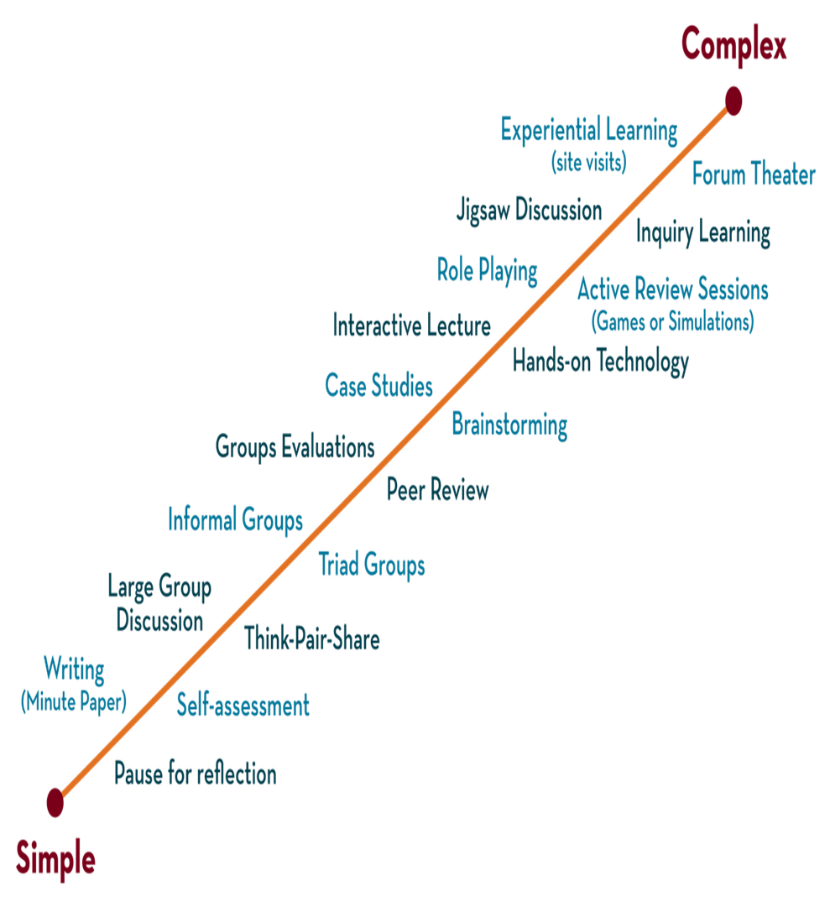
Department of CSE
DESIGN AND ANALYSIS OF ALGORITHMS
24CS2203
Topic:
Spanning Trees -MST
Greedy Method

Slide 2
Spanning Tree
Graph: Set of Vertices and edges G: { V,E }D
A tree is a connected undirected graph that contains no cycles.
i.e Tree : Tree is Graph T: { V,E} ➢ Acyclic ➢ N nodes ➢ N-1 edges
Note: Every Tree is a Graph , But Every Graph is not a Tree

Slide 3
Properties
A connected graph G can have more than one spanning tree.
All possible spanning trees of graph G, have the same number of edges and vertices.
The spanning tree does not have any cycle (loops).
Removing one edge from the spanning tree will make the graph disconnected, i.e. the spanning tree is minimally connected.
Adding one edge to the spanning tree will create a circuit or loop, i.e. the spanning tree is maximally acyclic.

Slide 4
Example:
1
A
B
A
1
B
A
B
5
4
2
4
2
4
6
D
C
D
C
D
C
3
3
3
1
1
Undirected Graph
A
B
A
B
2
2
4
D
C
D
C
3
Some Spanning Trees

Slide 5
Spanning Tree : A spanning tree of G is a sub graph T that is
Includes all of the vertices in given graph and vertices-1 edges.
𝑇 ⊆ 𝐺 𝑇: {𝑉′ = 𝑉, 𝐸′ ⊆ 𝐸} 𝑉′ = 𝑉 𝐸 = |𝑉| − 1
Spanning Tree properties:
A graph may have many spanning trees. If the Graph G: { V,E } then the possible spanning Trees are ECV-1
Removing one edge from the Spanning Tree Will make it as Disconnected graph
Adding one edge to the Spanning Tree will create a cycle.
If each edge has distinct weight then there will be only one & unique Minimum cost Spanning Tree.
Disconnected graph doesn’t have any Spanning Tree.

Slide 6
MST
A minimum spanning tree is the one among all the spanning trees with the smallest total cost or A Spanning tree with minimum weight
1
1
A
B
A
B
4
2
4
2
5
D
C
D
C
3
3
Undirected Graph
Minimum Spanning Tree

Slide 7
Applications
Computer Networks
How to connect a set of computers using the minimum amount of wire..
Civil Network Planning
Computer Network Routing Protocol
Cluster Analysis

Slide 8
Kruskal’s Algorithm
Kruskal's algorithm is a greedy algorithm in graph theory that finds a minimum spanning tree for a connected weighted graph.
This algorithm treats every node as an independent tree and connects one with another only if it has the lowest cost compared to all other options available.
Steps to Kruskal’s algorithm: • Sort the graph edges with respect to their weights. • Start adding edges to the minimum spanning tree from the edge with the smallest weight until the edge of the largest weight. • Only add edges which don’t form a cycle—edges which connect only disconnected components.

Slide 9
Kruskal’s Algorithm: MST KRUSKAL(G, w) T← Ø cost← 0 for each vertex v V[G] do MAKE-SET(v) sort the edges of E into nondecreasing order by weight w for each edge (u, v) E, taken in nondecreasing order by weight do if FIND-SET(u) ≠ FIND-SET(v) then T.E← T.E ∪ {(u, v)} UNION(u, v) cost ← cost+ cost(u,v) return cost

Slide 10
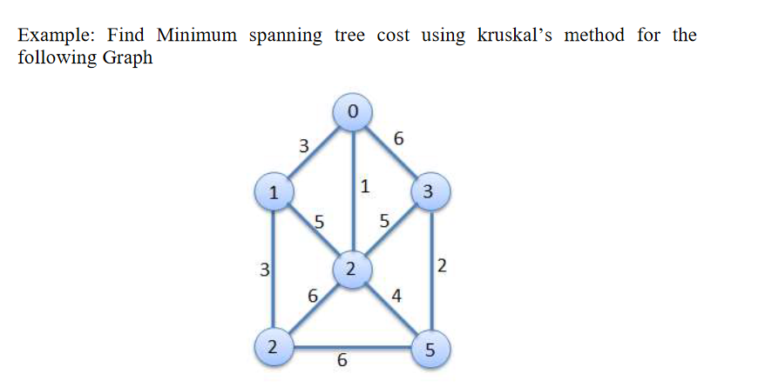

Slide 11
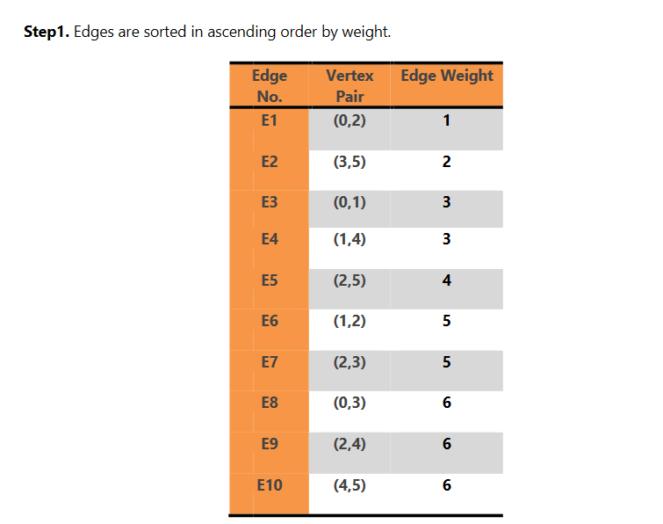

Slide 12
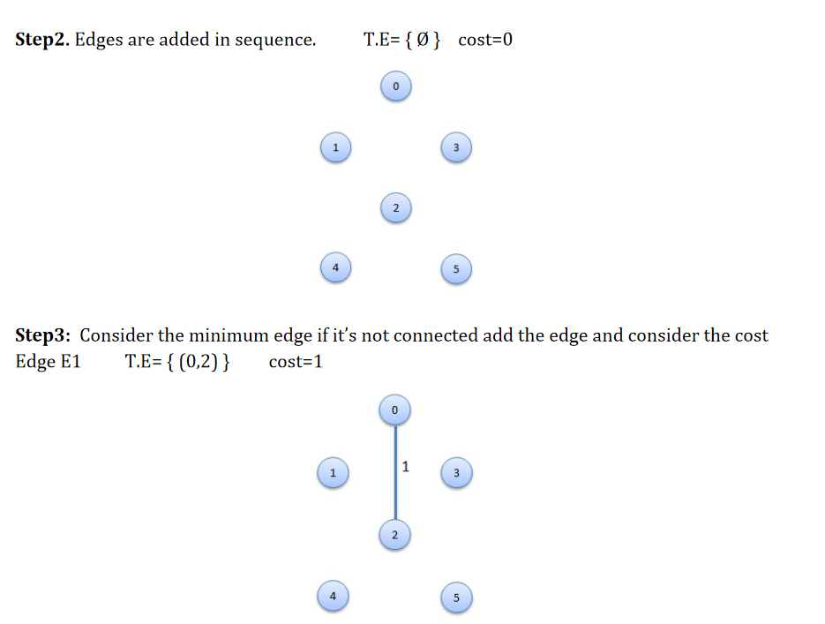

Slide 13
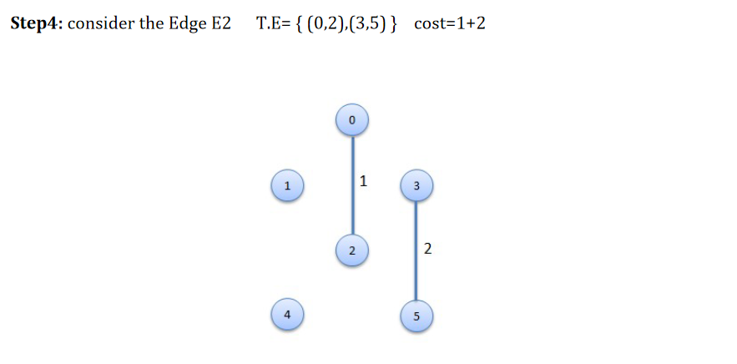

Slide 14
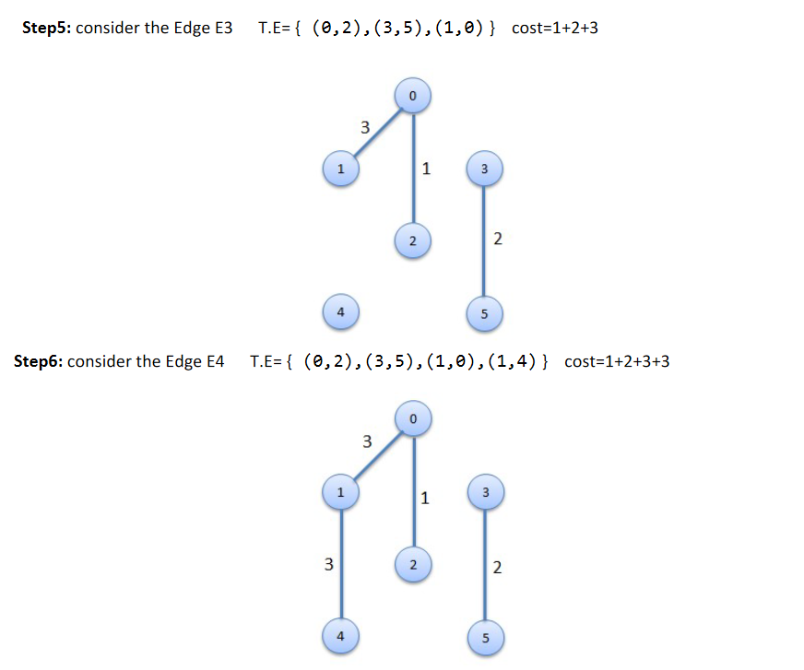

Slide 15
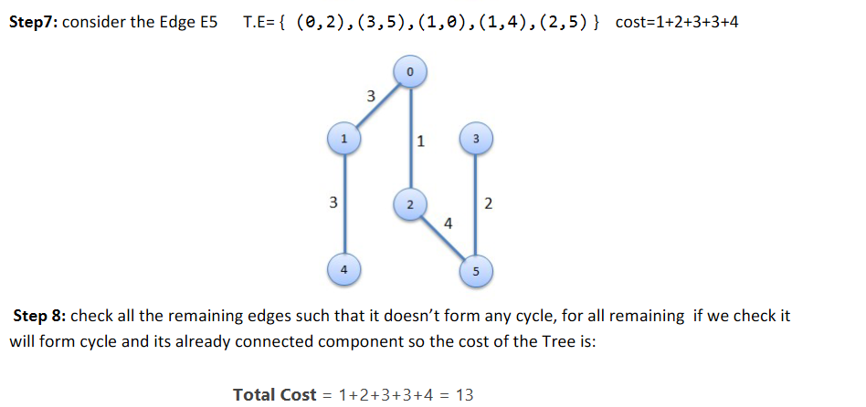

Slide 16
9
4
5
5
3
8
4
9
3
6
8
6
2
1
2
2
4
4
7
7
8
8
9
10
14
16
1
9
7
7
3
Does not form cycle
3
8
2
1
4
6
6
3
7
2
4
9
5
1
8
7
6
Forms cycle

Slide 17
Example
2
8
3
7
4
1
9
2
1
11
✗
9
4
14
5
✗
7
16
8
10
8
7
2
6
4
2
3
4
1
9
5
8
7
6

Slide 18
Time Complexity
With an efficient Find-set and union algorithms, the running time of kruskal’s algorithm will be dominated by the time needed for sorting the edge costs of a given graph.
Hence, with an efficient sorting algorithm( merge sort ), the complexity of kruskal’s algorithm is O( ElogE).

Slide 19
Prim’s Algorithm
Prim’s Algorithm is another greedy algorithm used for finding the Minimum Spanning Tree (MST) of a given graph.
The graph must be weighted, connected and undirected
Start with minimum cost edge.
For rest of the procedure, always select a minimum cost edge from graph make sure that already connected to the selected vertices.
Continue this process until the tree has n - 1 edges.

Slide 20
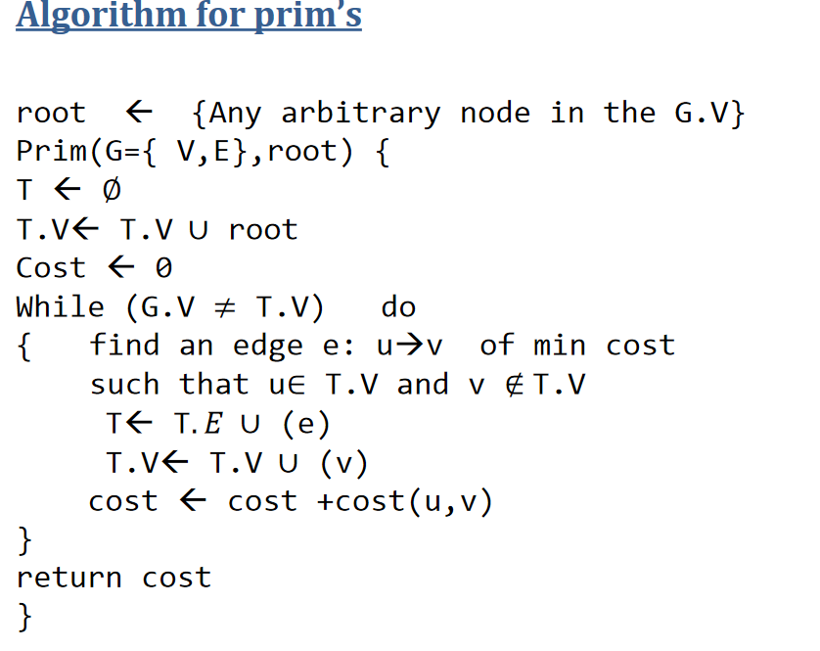

Slide 21
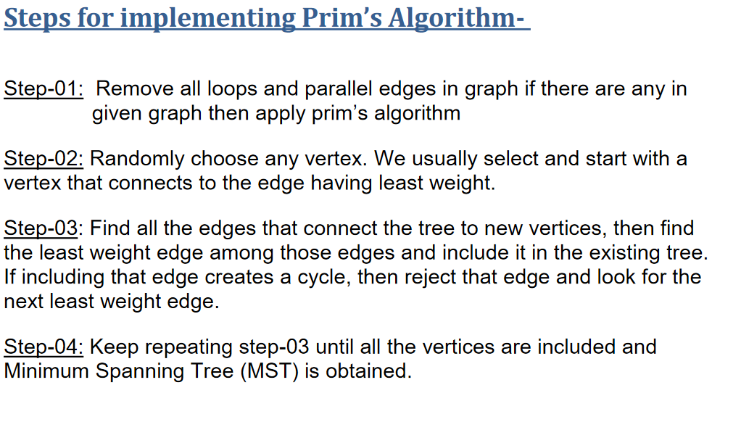

Slide 22
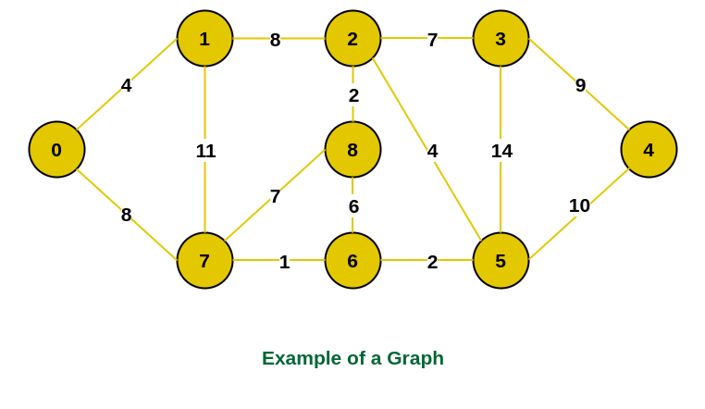

Slide 23
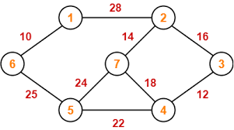

Slide 24
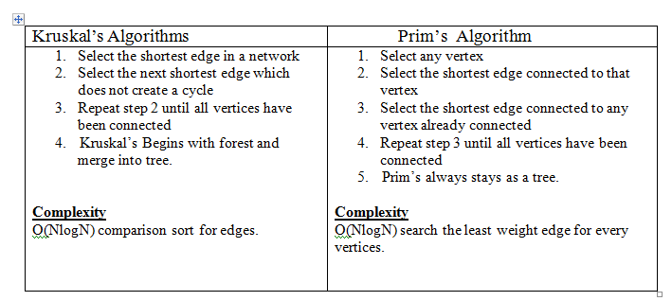
Differences

